Slide 1
Lecture
E-commerce

Slide 2
Main question
Title: Presentation
Subtitle field
Is e-commerce just another channel to distribute products
Or are there new economic issues?

Slide 3
Focus on information issues
Title: Presentation
Subtitle field
Information about products
Deezer 2014: 30m titles, 60% never streamed
Importance of recommendation systems
Information about agents
Information asymmetries and trust
Reputation system

Slide 4
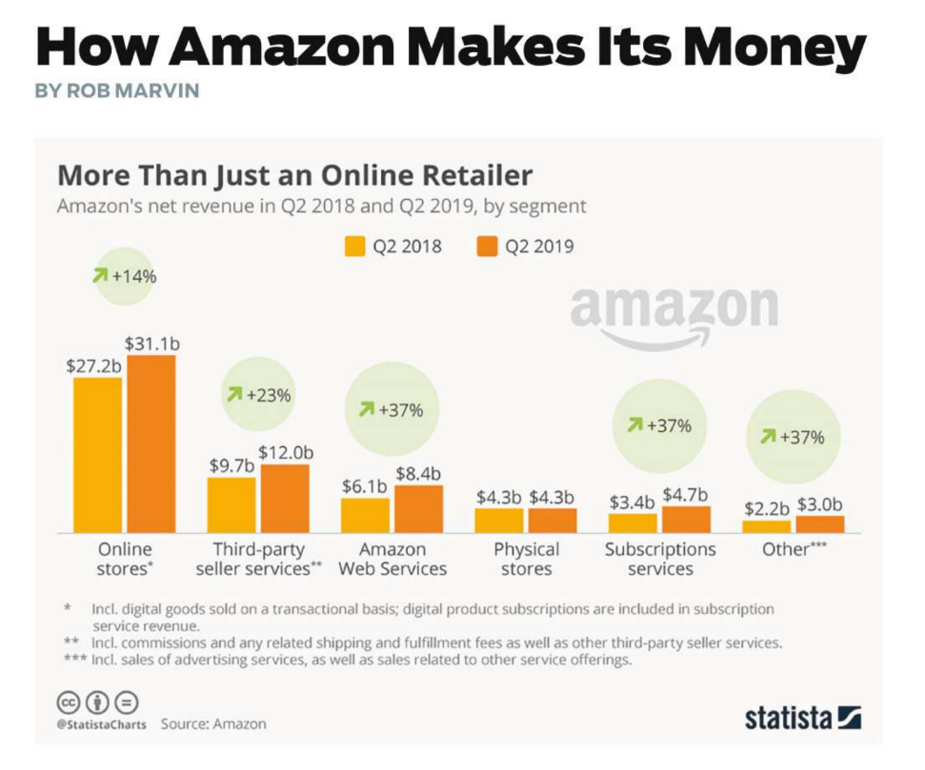
e-commerce activities
Title: Presentation
Subtitle field

Slide 5
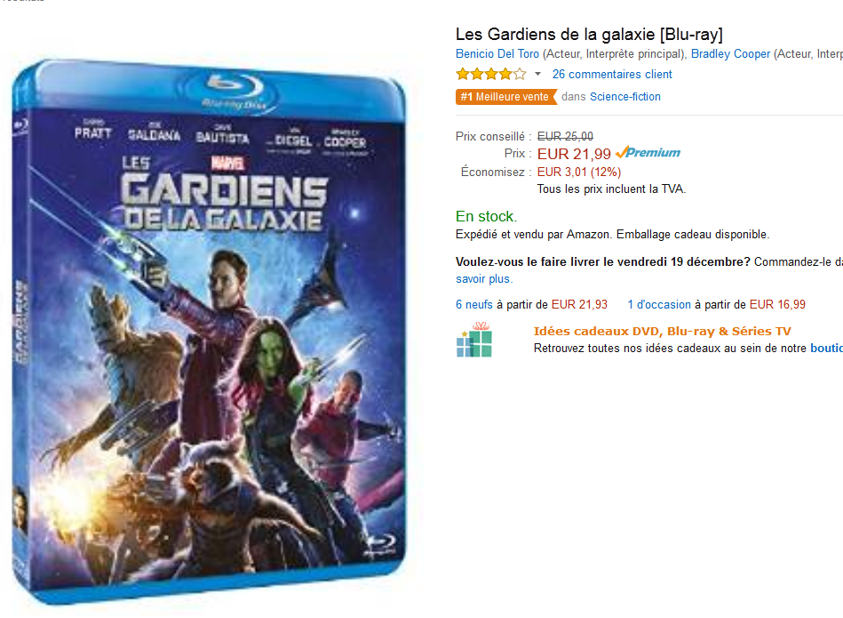
Explaining price dispersion
Title: Presentation
Subtitle field

Slide 6
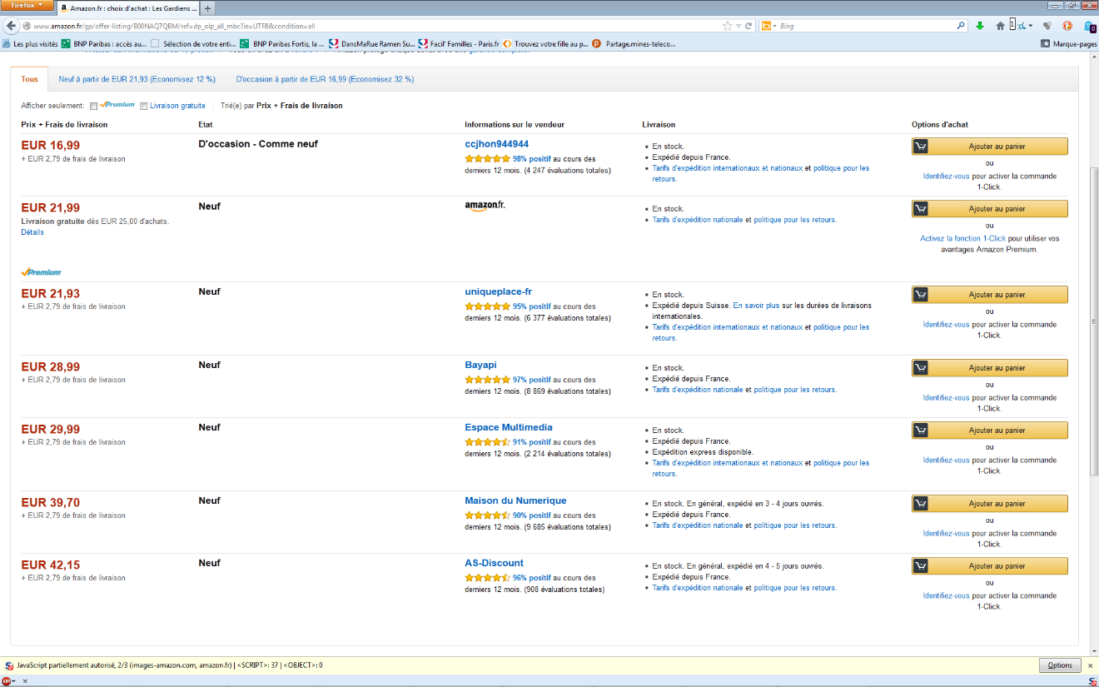
Explaining price dispersion
Title: Presentation
Subtitle field

Slide 7
puzzle
Title: Presentation
Subtitle field
Fact: price dispersion started with the development of e-commerce and is here to stay
Estimated at about 15% (= standard deviation of prices)

Slide 8
Possible explanations
Title: Presentation
Subtitle field
Search costs
External: time spent searching
Internal: cognitive costs
Estimation:
15 USD for medical drugs
3.5 USD for portable audio device (MP3)
6 USD for personal assistants (PDA)
Mixed strategies of gatekeepers can generate price dispersion with consumer search costs.

Slide 9
Cannot explain price rigidities
Title: Presentation
Subtitle field
Prices change little:
Amazon changes prices every 151 days,
Barnes and Noble 49 days;
Amazon lowers prices on average 74 days in response to Barnes and Noble;
People don't visit many sites per month: 1.2 book sites, 1.3 CD sites, 1.8 travel agency sites .
Old numbers, but we will come back to that.

Slide 10
New explanations
Title: Presentation
Subtitle field
Different segments of consumers: informed and uninformed.
Obfuscation strategies
// shopping mall
Price discrimination, versioning bundle make it harder for consumers to compare offers

Slide 11
Best explanation:
Title: Presentation
Subtitle field
Perhaps the nature of competition in online platforms is not price competition
If reputation matters, consumers prefer to stay with well known merchants even it means paying a higher price
Implication: reputation premium
Empirically observed (I will come back to that)

Slide 12
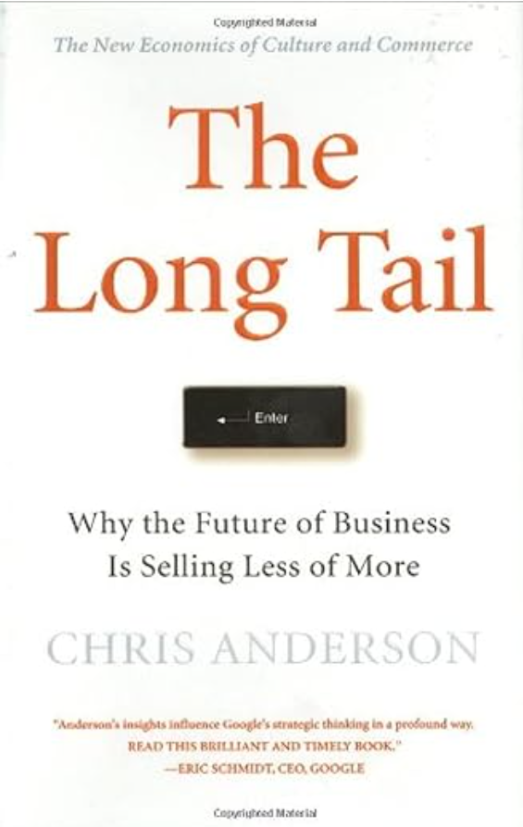
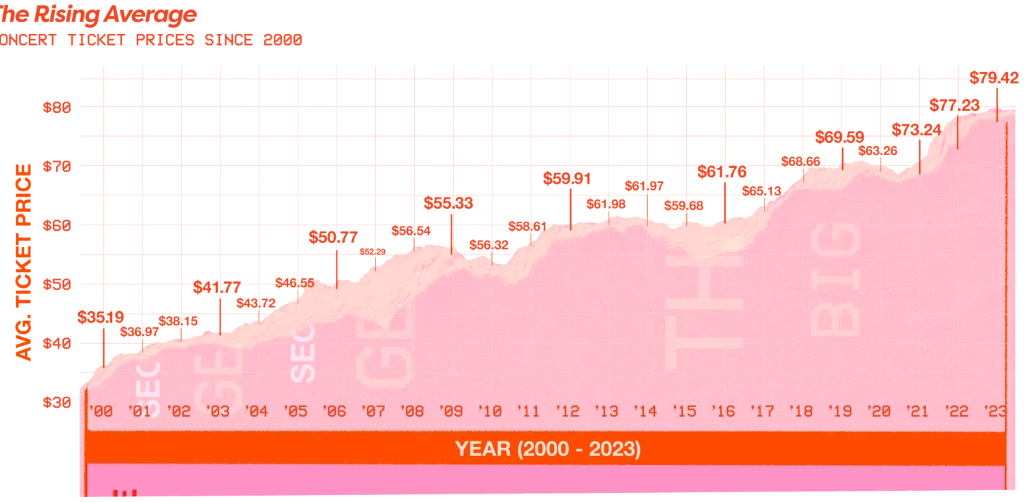
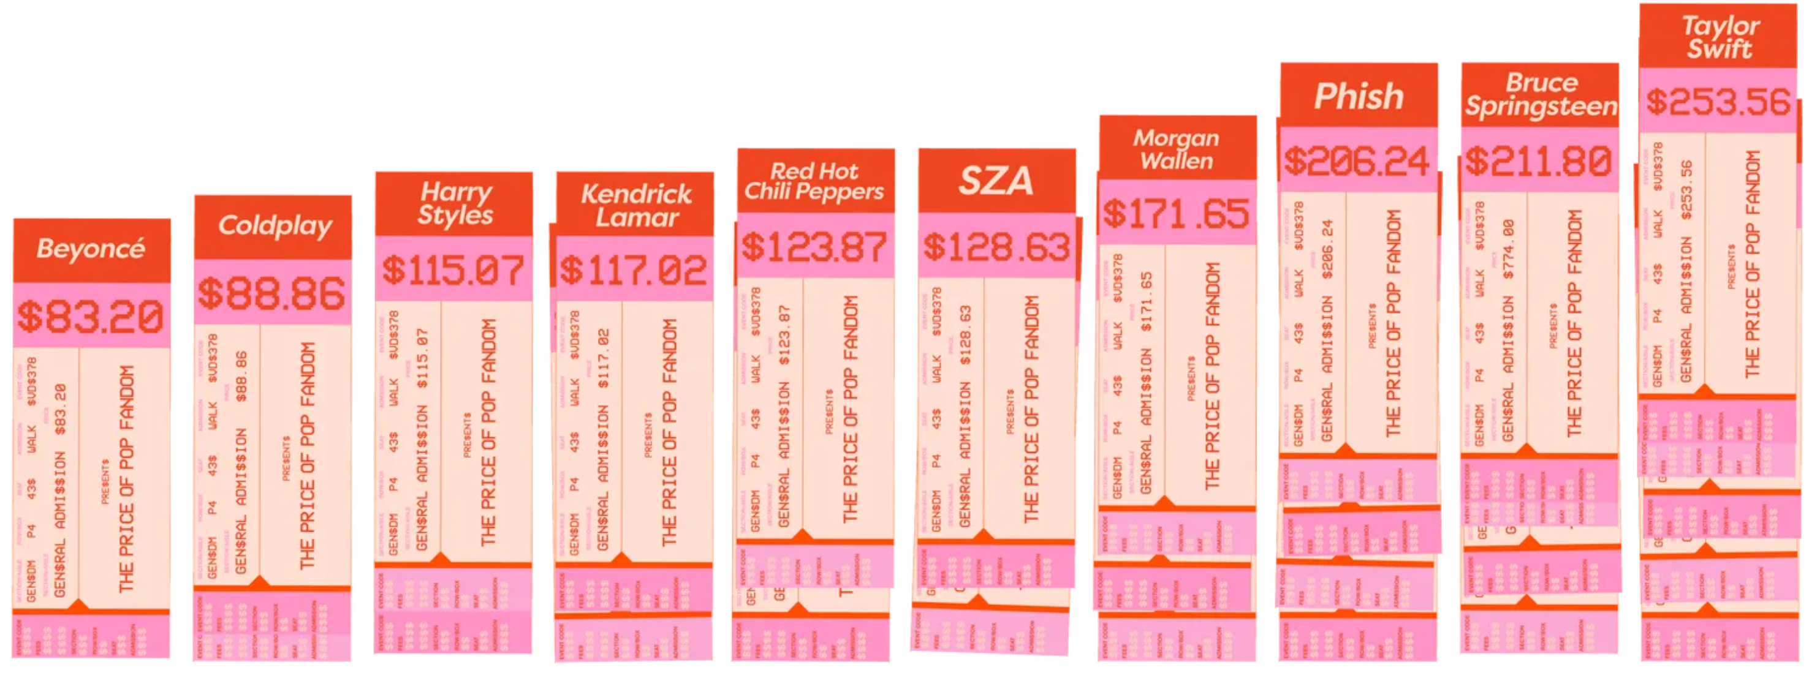
Long tail vs. Superstars
Title: Presentation
Subtitle field
Chris Anderson : end of scarcity, beginning of abundance
More than 2m book titles on Amazon
Impossible in physical stores
Distribution of sales flattens
But: Superstar concert tickets have soared to all time high

Slide 13
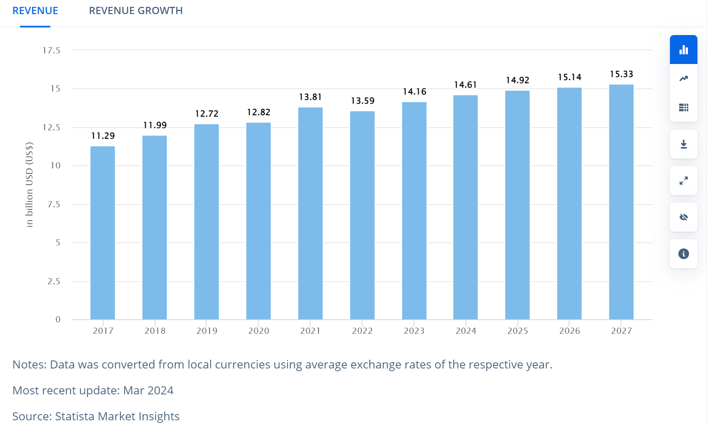
Ebook sales
Title: Presentation
Subtitle field
Amazon currently sells more e-books for Kindle than print books.
Cannibalization of print book sales by ebooks?
Or is there something else going on?

Slide 14
Economics of superstars
Title: Presentation
Subtitle field
Rosen, 1972
Two hypotheses:
1) Non-homogeneous distribution of talents, observables
Imperfect substitution: 1 very good > two average
Very strong complementarity between tasks
// O-ring theory of economic development
M. Kramer

Slide 15
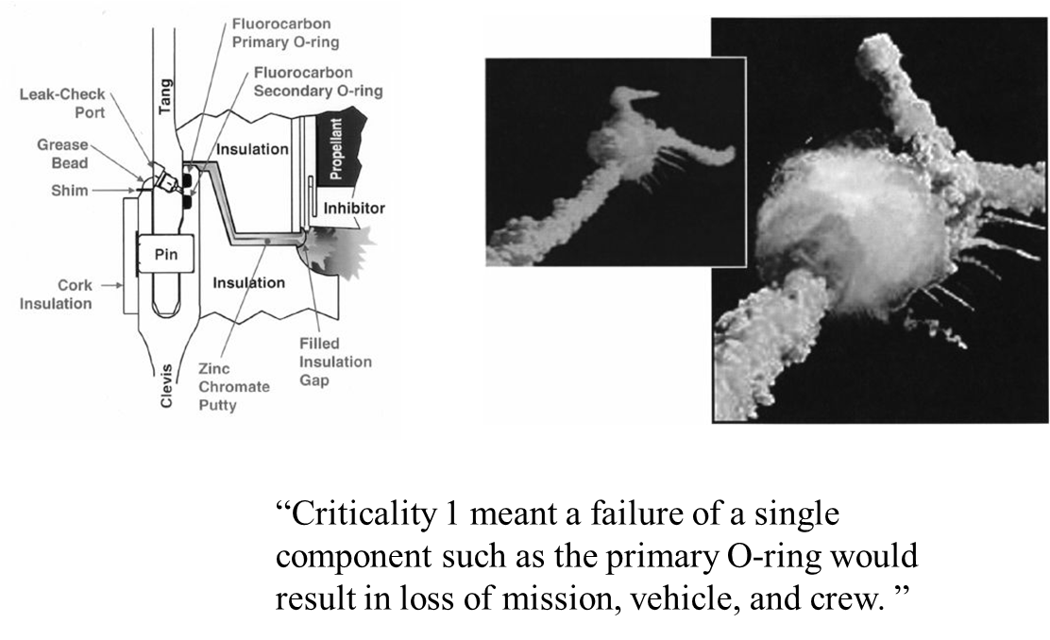
O-ring
Title: Presentation
Subtitle field

Slide 16
Economics of superstars (cont.)
Title: Presentation
Subtitle field
2) Production and distribution costs not proportional to demand
Consequence:
winners take all
pareto principle/distribution
Superstars are reinforced with mass-media technologies
Is the Internet a mass media technology?

Slide 17
The long tail of e-commerce: introduction
Title: Presentation
Subtitle field
Discussion forums, interactive searches, user opinions
Discovery of new talents, emergence of micro-culture around communities
From the economy of scarcity to the economy of abundance
Anderson: volume of niche titles/albums can generate substantial profits that can challenge the Pareto distribution

Slide 18
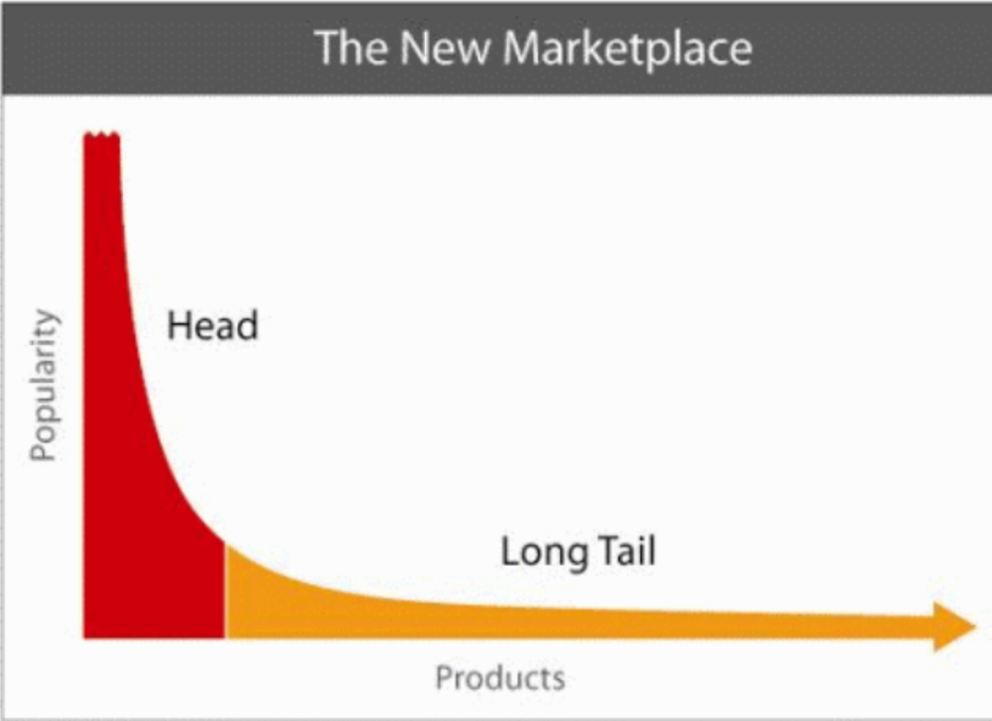
The long tail
Title: Presentation
Subtitle field

Slide 19
Paradox of the long tail
Title: Presentation
Subtitle field
Elberse - Oberholzer-Gee: VHS DVD in the USA; 2006
Strengthening superstars and the long tail
Exploiting the long tail is not commercially profitable
Benghozi and Benhamou: CDs and DVDs in FRance, 2005-2008
There is a seasonal dynamic to the long tail (unrecognized titles outside holiday periods)
Pareto phenomenon dominates: 10/90, even if the long tail is more present on the Internet

Slide 20
Reputation systems: introduction
Title: Presentation
Subtitle field
Problem: how can you trust people you have never met?
Solution: introduce a rating system for buyers and sellers
But: why rate?
Free rider problem
Contribution to public good < positive externality
Wikipedia : 90-9-1

Slide 21
Ebay reputation system
Title: Presentation
Subtitle field

Slide 22
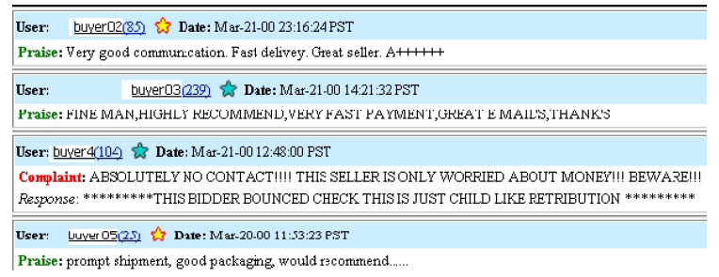
Ebay reputation system (cont.)
Title: Presentation
Subtitle field

Slide 23
Ebay reputation system (cont.)
Title: Presentation
Subtitle field

Slide 24
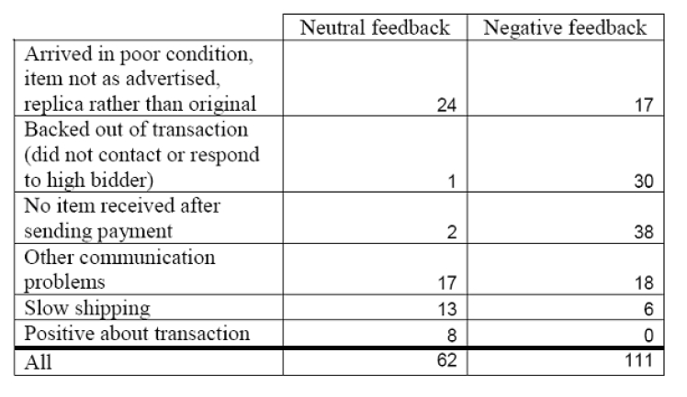
Ebay reputation system (cont.)
Title: Presentation
Subtitle field

Slide 25
Reputation systems: Effect on price and volume
Title: Presentation
Subtitle field
RZ2002: no effect on price, effect on transaction probability (MP3 player; ebay)
HW2005: elasticity price/ratings positive = 0.017; negative = -0.024 (pentium III processor; eBay)
GIS2005: increasing margin with valuation (software, amazon marketplace)
Recent work has confirmed the existence of a reputation premium of about 10%

Slide 26
conclusion
Title: Presentation
Subtitle field
E-commerce = another distribution channel?
Are people substituting online purchases for physical ones?
- No,
Market expansion:
online communities and information diffusion, long tail
Resolution of information asymmetries through recommendation systems

Slide 27
Title
Subtitle

